Slide 1
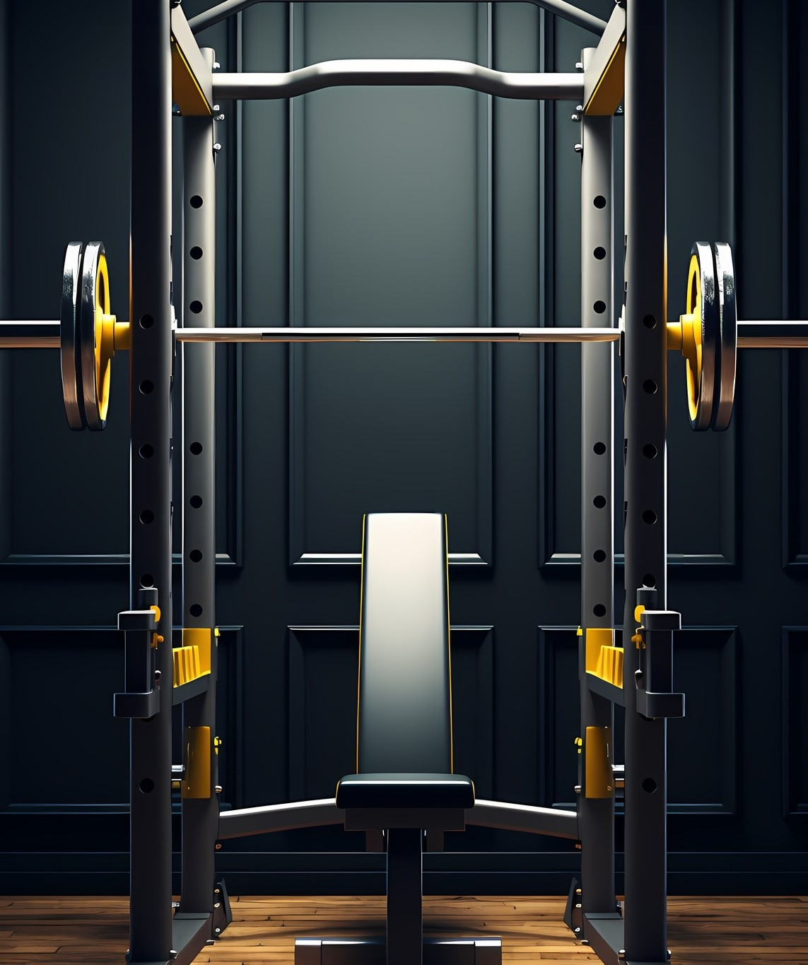

Introduction
Objective:
To develop a modern, user-friendly, and responsive static website for Diksha's Fitness Studio.

Slide 2

Project Scope
The project involves creating a visually appealing homepage with a navigation menu.
Users can view information about the studio's services, trainers, and testimonials.
The gallery section showcases success stories and before-and-after transformations.

Slide 3

Design Principles and Features
The website features a modern and energetic design that resonates with the fitness theme.
Color schemes are chosen to evoke motivation and positivity.
Typography and layout are optimized for readability and visual appeal.
The website is designed for easy navigation and quick access to information.
Interactive elements such as sliders and image galleries enhance user engagement.
Mobile responsiveness ensures a seamless experience across devices.

Slide 4
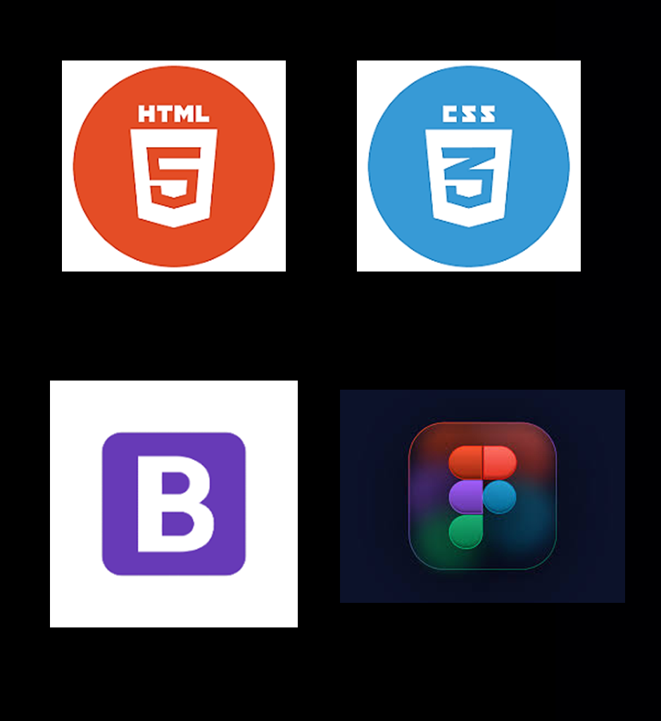
Technologies used:
HTML: HTML used for structure webpages, providing a solid foundation for design and content layout, enabling easy navigation for users.
CSS: CSS styles used for styling and arranging visual elements, ensuring an appealing design and responsive interface across various devices and screen sizes.
Bootstrap: We chose Bootstrap, a widely-used CSS framework, to make the most of its pre-built components, grid systems, and responsive layouts. This facilitated a more streamlined development process and resulted in consistent styling throughout the site.
Figma: I leveraged Figma for designing, refining, and finalizing the website's visuals, leading to improved collaboration and streamlined workflow.

Slide 5
Challenges:
Ensuring consistent design across different browsers and devices
Balancing visual aesthetics with website performance
Exporting designs from Figma to HTML and CSS with minimal loss of fidelity

Slide 6
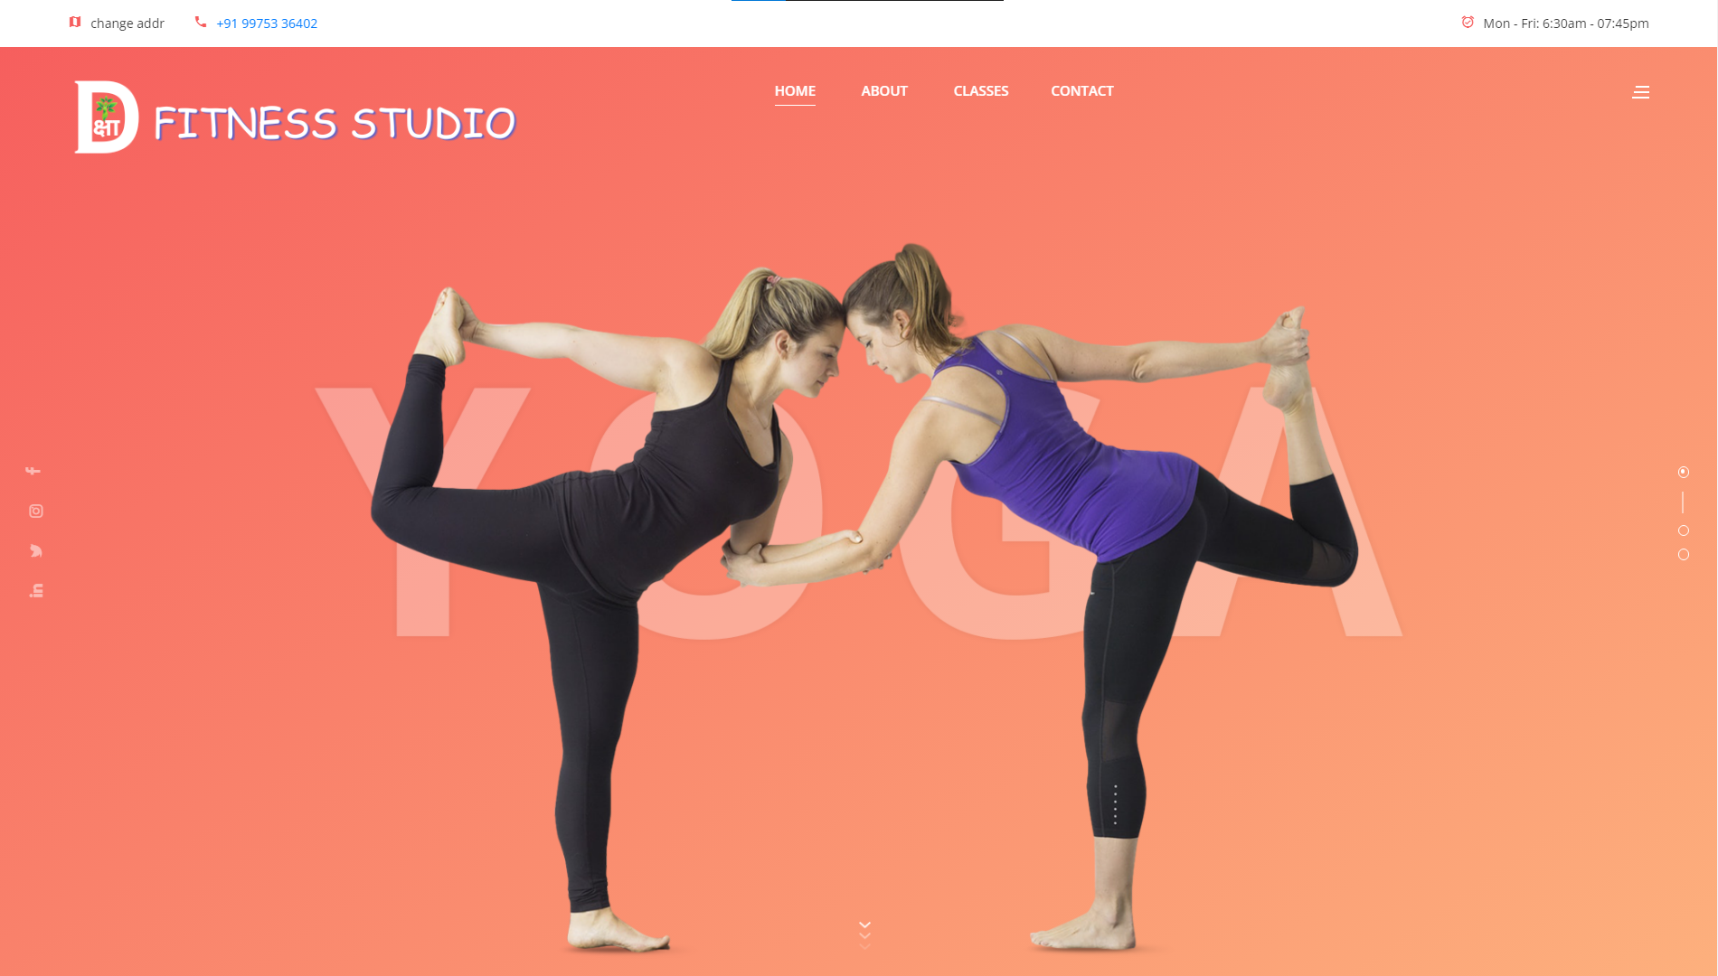
Home page Design

Slide 7
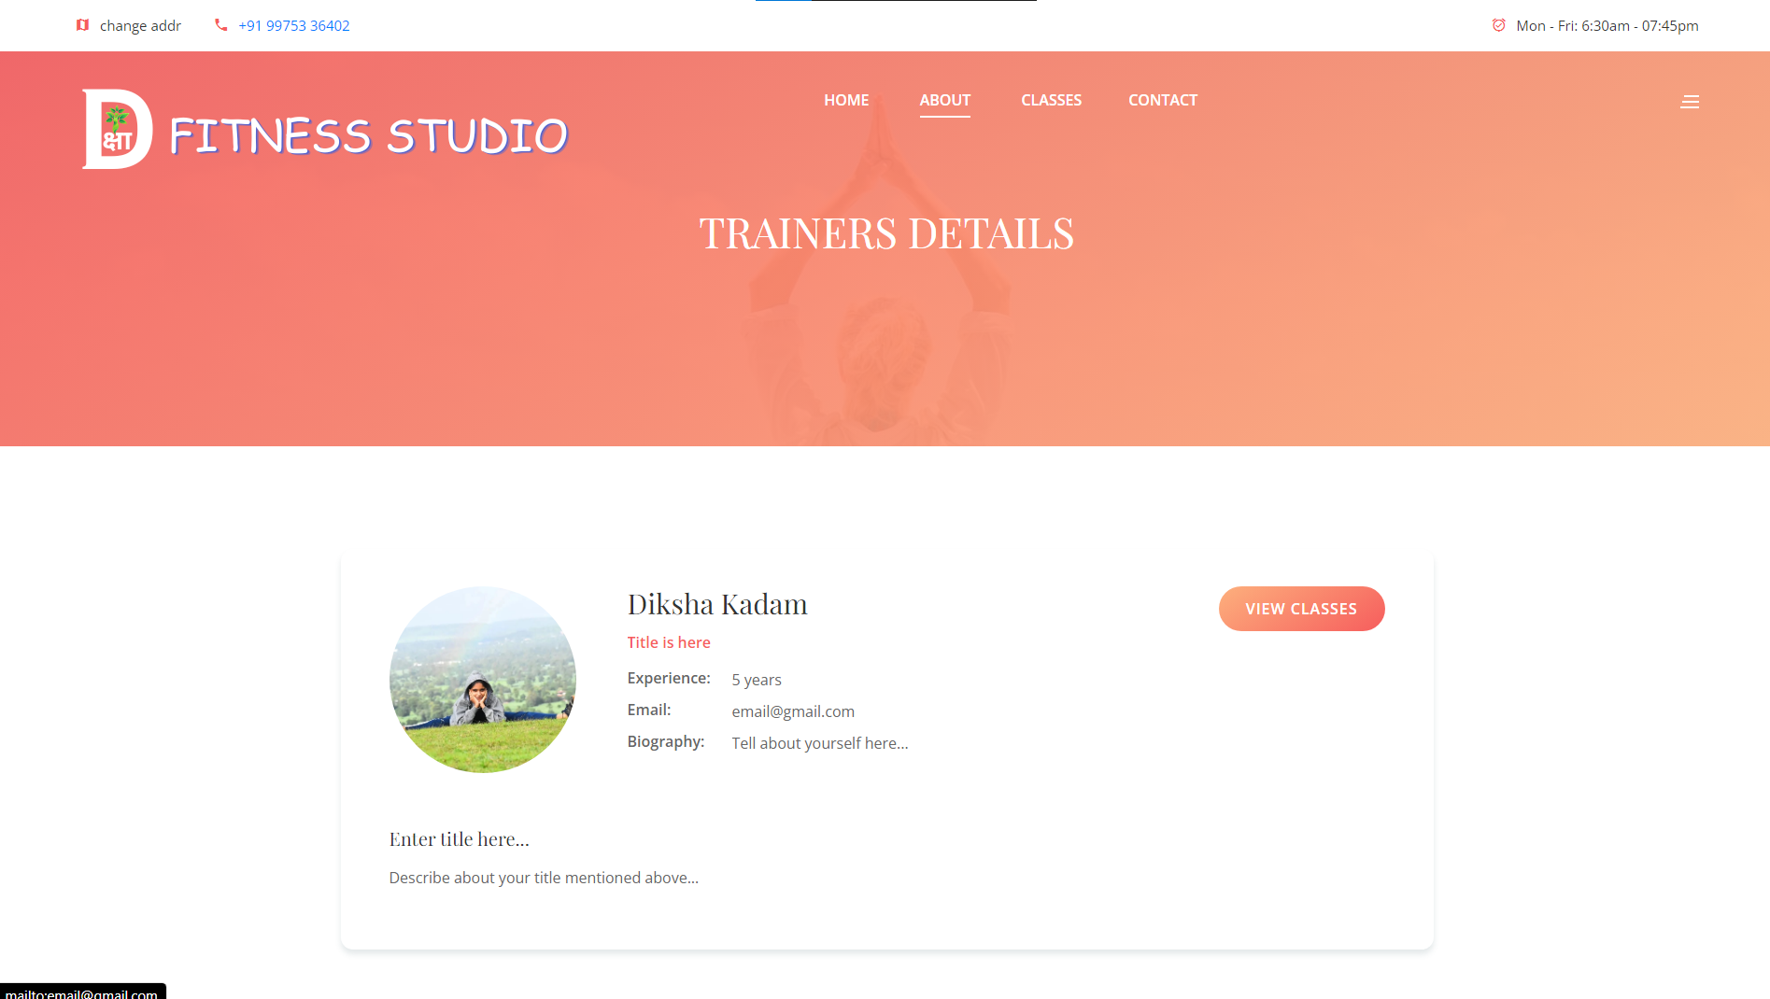
About page Design

Slide 8
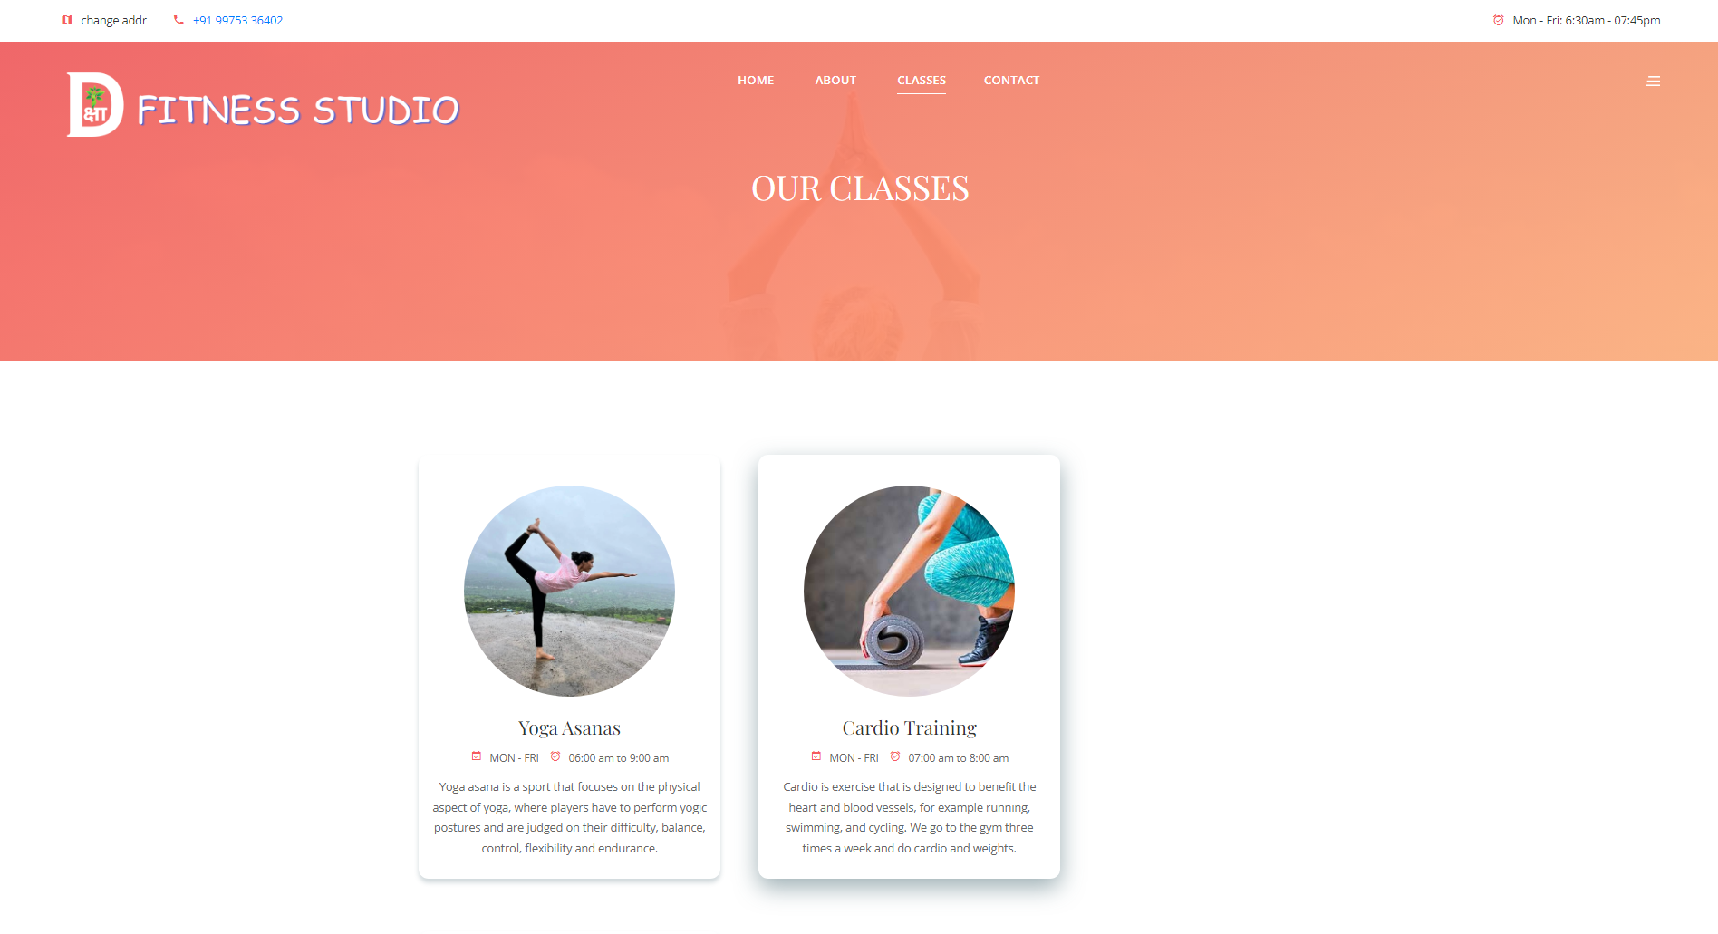
Classes page Design

Slide 9
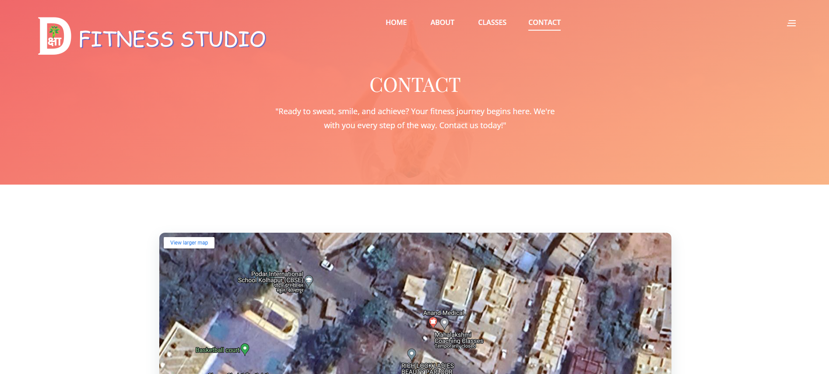
Contact page Design

Slide 10
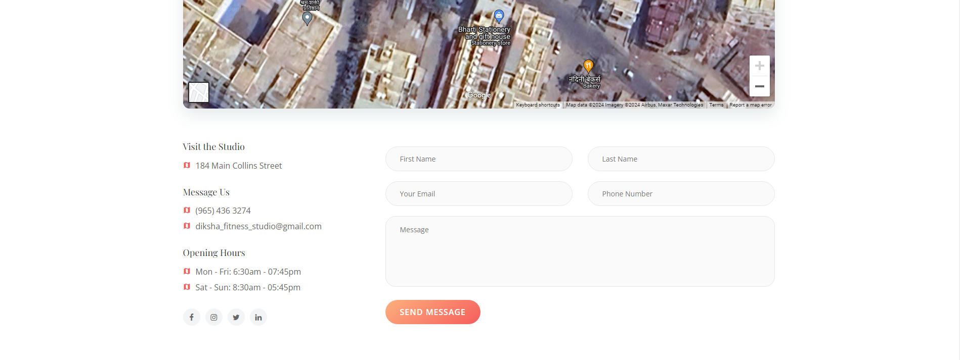
Note : Ajax is used to send the form data to Backend Database.

Slide 11
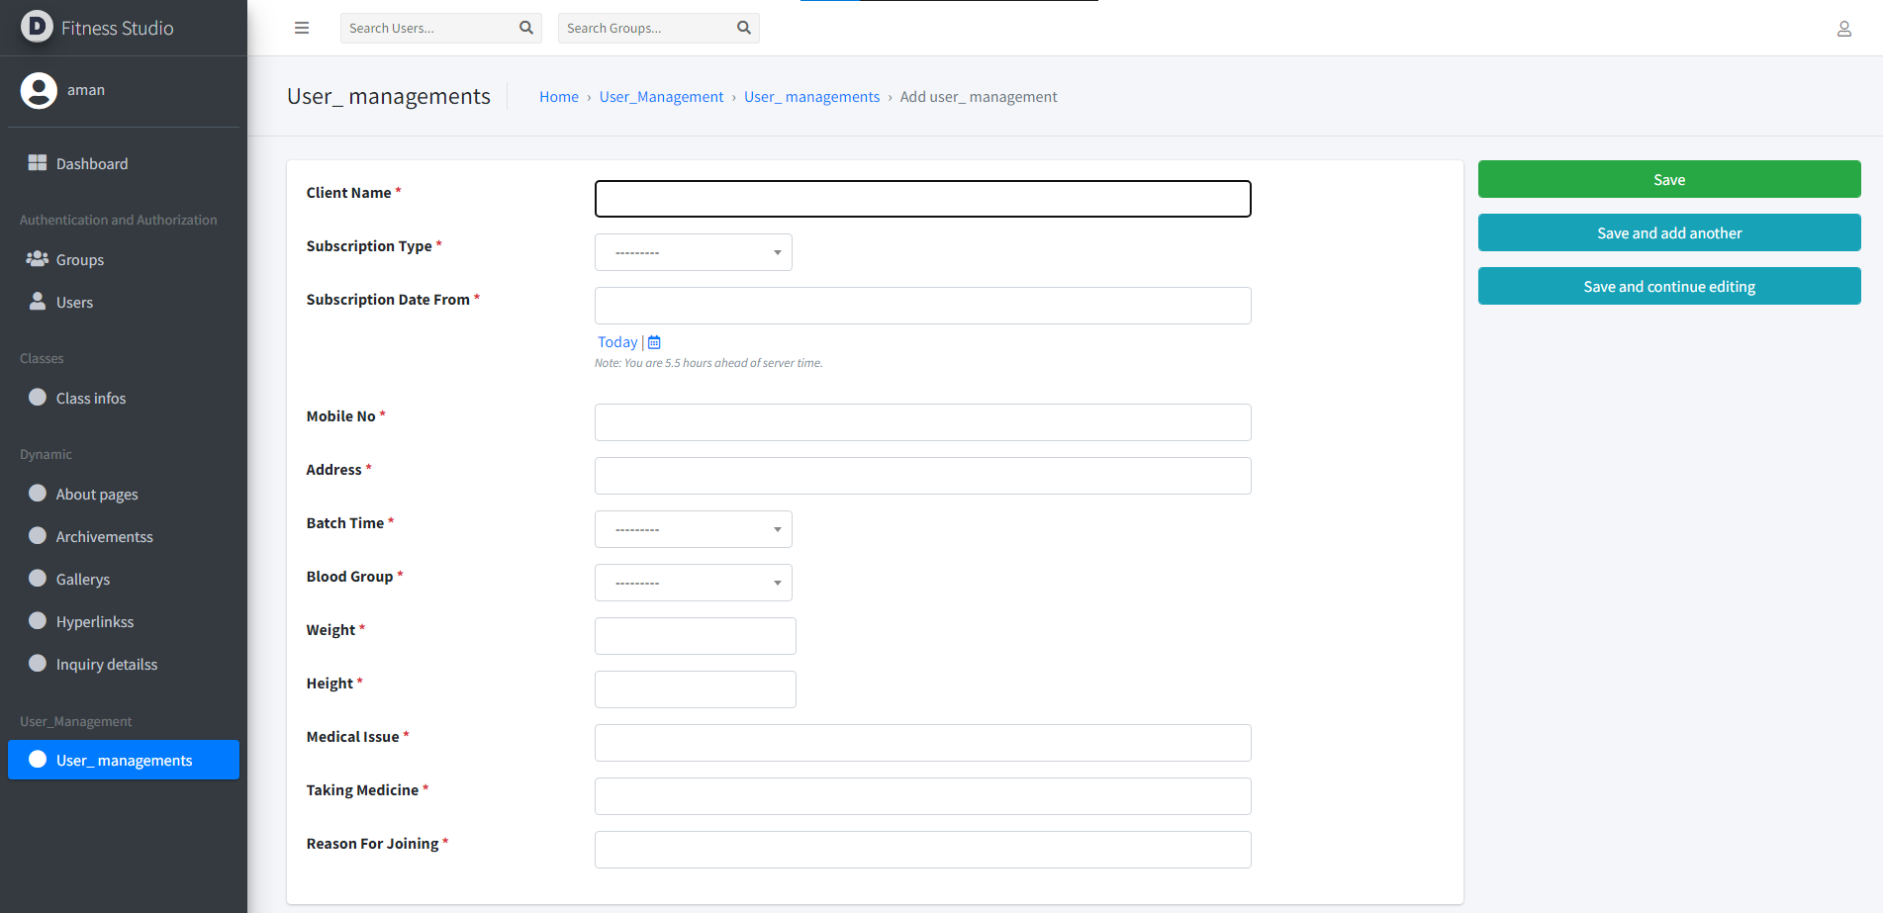
Additional Work :
(User Management module in Admin Panel)

Slide 12
Deployment on Vercel
Platform for free and efficient deployment solution for project
Using Vercel’s postgreSQL DB and their blob storage for faster interoperability
Provides reliable hosting, scalable infrastructure, and easy integration with third-party services.
Ensures the website is accessible to users with minimal downtime
Live Deployed URL: dikshafitness.vercel.app

Slide 13
Conclusion
The Dynamic Portfolio Website Project for Diksha's Fitness Studio represents a successful collaboration of design and development.
The frontend module has created a visually appealing and user-friendly interface for showcasing the studio's offerings.
This project sets a new standard for online presence in the fitness industry.

Slide 14
Thanks!

